Slide 1
HW1 Tutorial

Slide 2
IDE & Kit
Visual Studio 2019 – Community (download here)
GLFW (provided in zip)
An Open Source, multi-platform library for OpenGL
Provides a simple API for creating windows, receiving input and, etc.
GLAD(provided in zip)
An openGL loading library that loads pointers to OpenGL functions at runtime
GLM(provided in zip)
Math library for OpenGL

Slide 3
Architecture
Initialize
Create window
Callback register
Load model, texture, etc.
display initialize
Display loop
Create window content
Handle Event

Slide 4
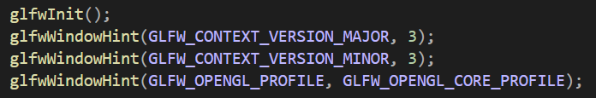
Initialize and window
int glfwInit()
Initialize GLFW
Return GLFW_TRUE while succeed, else GLFW_FALSE
void glfwWindowHint(int hint, int value)
Window setting for next window creation
In this homework,
we’re using openGL 3.3 core profile

Slide 5
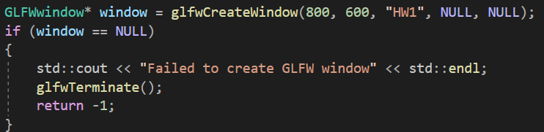
Initialize and window
GLFWwindow* glfwCreateWindow(int width, int height, const char* title, GLFWmonitor* monitor, GLFWmonitor* share)
Create window with specified width, height and title
monitor: monitor used for full screen mode, NULL for window mode
share: the window to share resource with, NULL to not share resource
Return the handle of the created window, or NULL if an error occurred

Slide 6
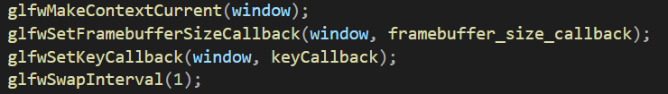
Initialize and window
void glfwMakeContextCurrent(GLFWwindow* window)
Make context current for the calling thread
GLFWframebuffersizefun glfwSetFramebufferSizeCallback(GLFWwindow* window, GLFWframebuffersizefun cbfun)
GLFWkeyfun glfwSetKeyCallback(GLFWwindow* window, GLFWkeyfun cbfun)
Register callback function for window resize and key event
void glfwSwapInterval(int interval)
set the number of screen updates to wait from the time glfwSwapBuffers() was called before swapping the buffers and returning

Slide 7
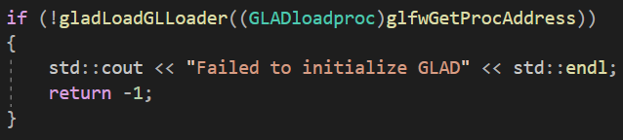
Initialize and window
gladLoadGLLoader((gladloadproc)glfwgetprocaddress)
Initialize GLAD to get OpenGL function pointer

Slide 8
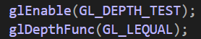
Depth test
To prevent occluded faces being rendered, we need to enable depth testing
void glEnable(GL_DEPTH_TEST)
While depth test enabled, OpenGL tests depth value of each fragment against the content in the depth buffer. If the test passes, the fragment is rendered. If not, the fragment is discarded
void glDepthFunc(GLenum func)
Specify how the test is performed.
func: GL_NEVER, GL_LESS, GL_EQUAL, GL_LEQUAL, GL_GREATER, GL_GEQUAL, GL_NOTEQUAL, GL_ALWAYS
GL_LEQUAL: test passes if fragment depth <= depth stored in buffer

Slide 9
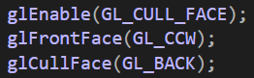
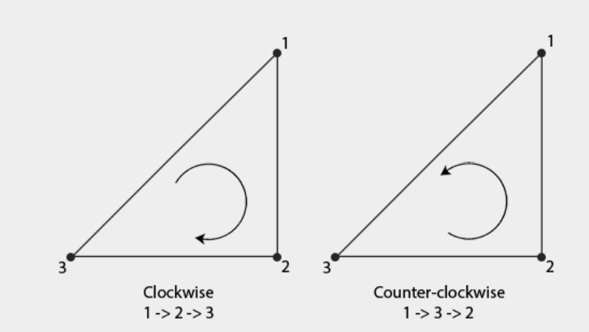
Face culling
Face culling reduces the number of faces rendered by discarding face not visible
void glEnable(GL_CULL_FACE)
Tell OpenGL to enable face culling
void glFrontFace(GLenum mode)
mode: GL_CW, GL_CCW
Faces with specified ordered vertices are defined front
void glCullFace(GLenum mode)
mode: GL_FRONT, GL_BACK, GL_FRONT_AND_BACK
Cull specified faces

Slide 10
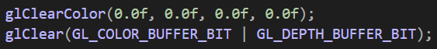
Display loop
Before we start to draw, we first need to clear the color buffer and depth buffer
void glClearColor(GLfloat red, GLfloat green, GLfloat blue, GLfloat alpha)
Set the color value OpenGL uses to reset color buffer
void glClear(GLbitfield mask)
Clear specified buffer
mask: GL_COLOR_BUFFER_BIT: clear color buffer
GL_DEPTH_BUFFER_BIT: clear depth buffer

Slide 11
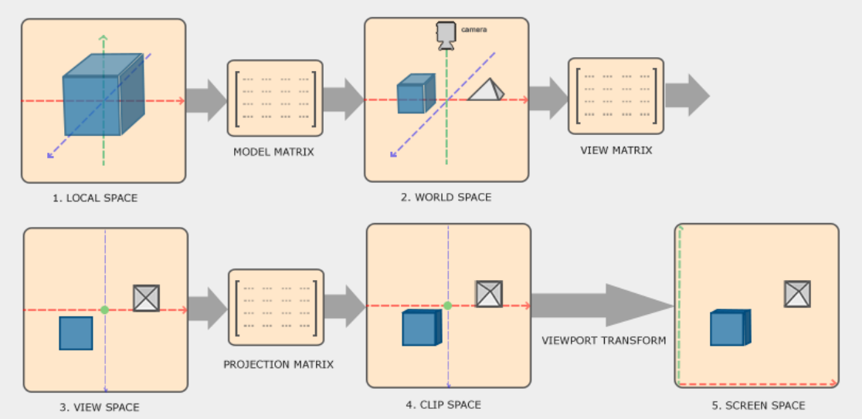
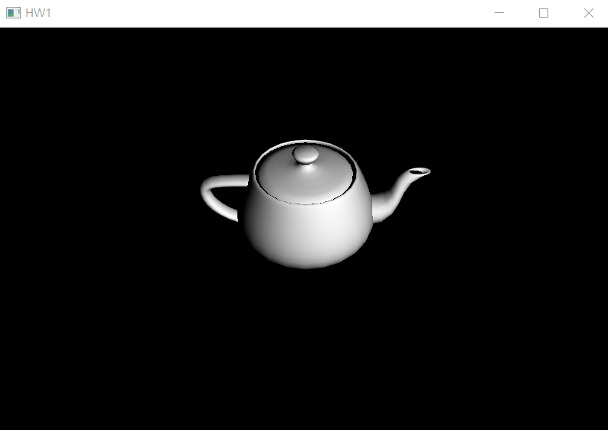

Draw a model
void DrawModel(const char* target, glm::mat4 M, glm::mat4 V, glm::mat4 P)
Draw the target model (teapot, base, cat, ball)
M: model matrix.
V: view matrix.
P: projection matrix

Slide 12
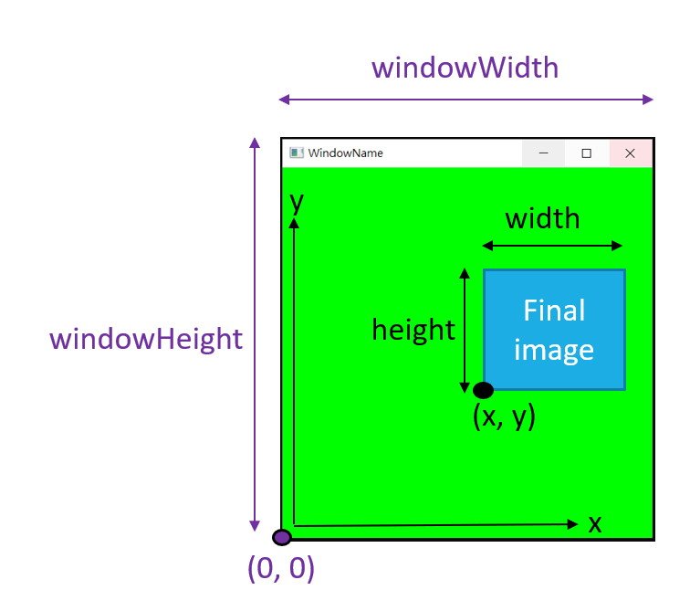
Draw a model
void glViewport(GLint x, GLint y, GLint width, GLint height)
Specify the viewport rectangle

Slide 13
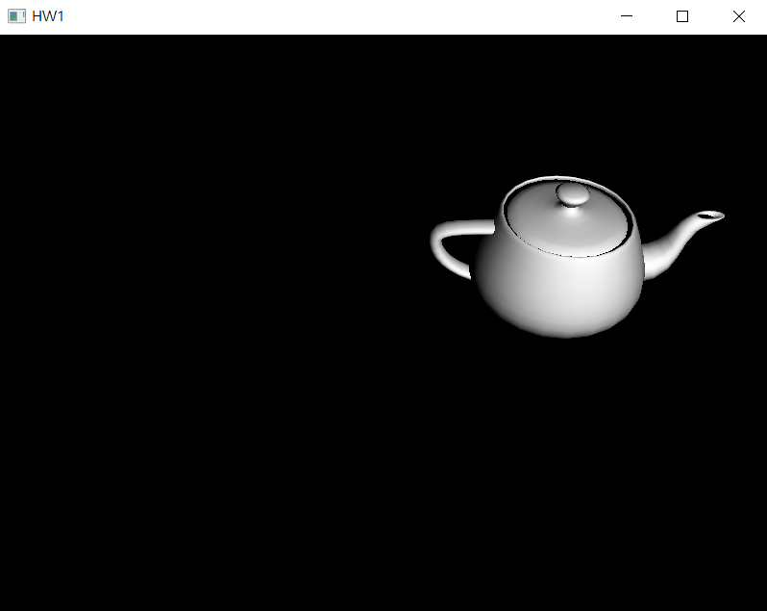
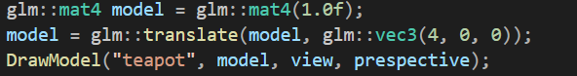
Model matrix
glm::translate(glm::mat4 M, glm::vec3 translation)
Returns M * (translation matrix)

Slide 14
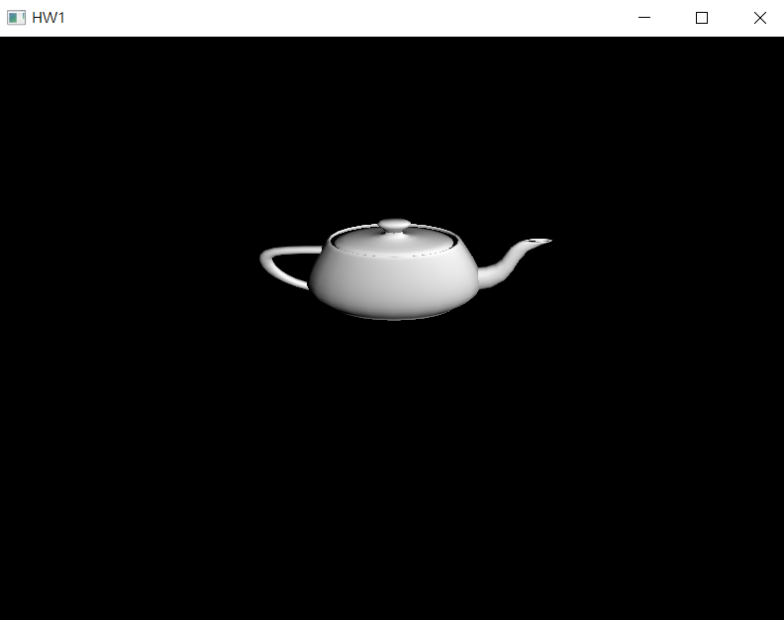
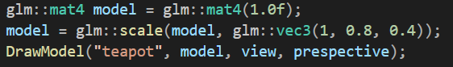
Model matrix
glm::scale(glm::mat4 M, glm::vec3 scale)
Returns M * (scale matrix)

Slide 15
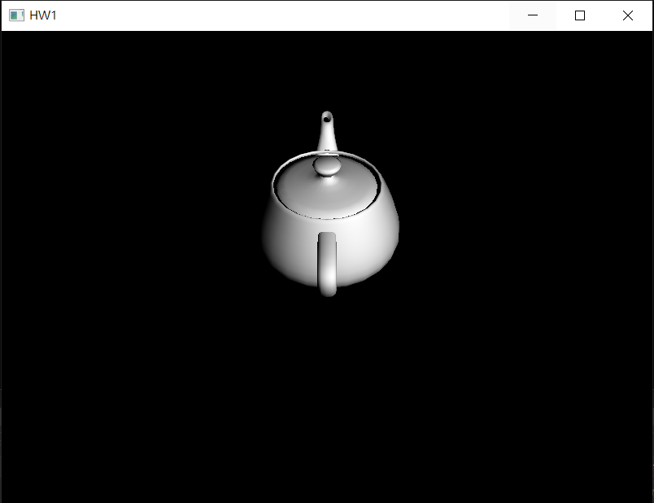

Model matrix
glm::rotate(glm::mat4 M, GLfloat angle, glm::vec3 axis)
Returns M * (rotation matrix)
The rotation matrix rotate angle about axis in radians
glm::radians(GLfloat degree)
Transform degree to radian

Slide 16
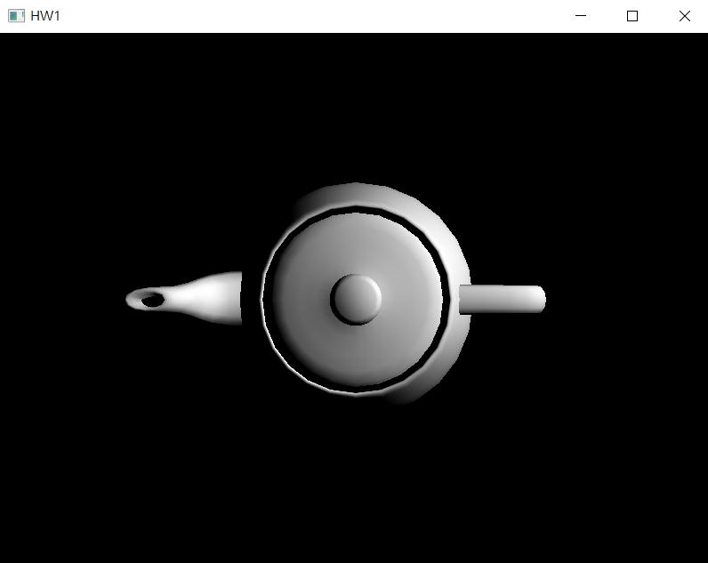
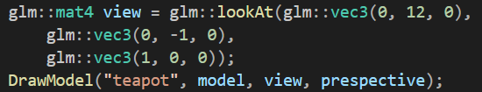
View matrix
glm::lookAt(glm::vec3 position, glm::vec3 target, glm::vec3 up)
Returns view matrix with camera at position looking at target with up vector
up
target
position

Slide 17
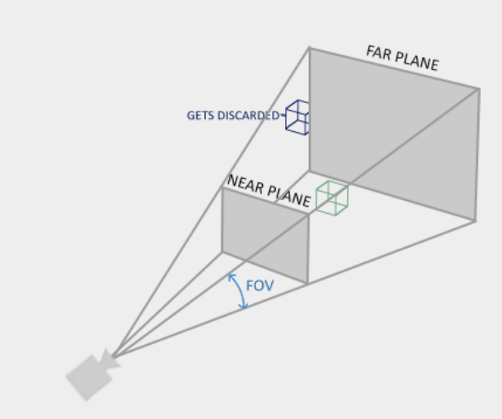
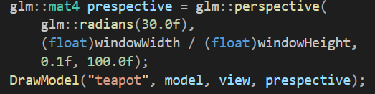
Projection matrix
glm::perspective(GLfloat fov, GLfloat aspect, GLfloat near, Glfloat far)
Returns perspective projection matrix with above parameters
fov: specify Field of View in radians
aspect: specify aspect ratio of the scene
near: specify near plane
far: specify far plane
Coordinates in front of near plane or behind far plane will not be drawn

Slide 18
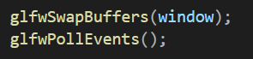
Display loop
void glfwSwapBuffers(GLFWwindow* window)
Swap buffer at the end of display loop
void glfwPollEvent()
Handle the event occurred while rendering the frame, if any

Slide 19
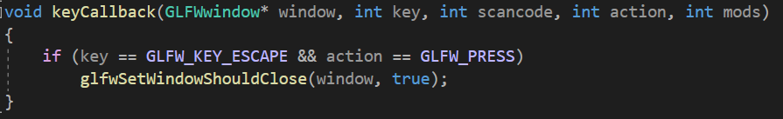
Key callback
Previously the above function is registered for key callback. We can check for key events and act correspondingly.
The above function set WindowShouldClose to true when escape key is pressed, which exit the display loop.
The full list of key can be found here.
The full list of action and their effects can be found here.

Slide 20
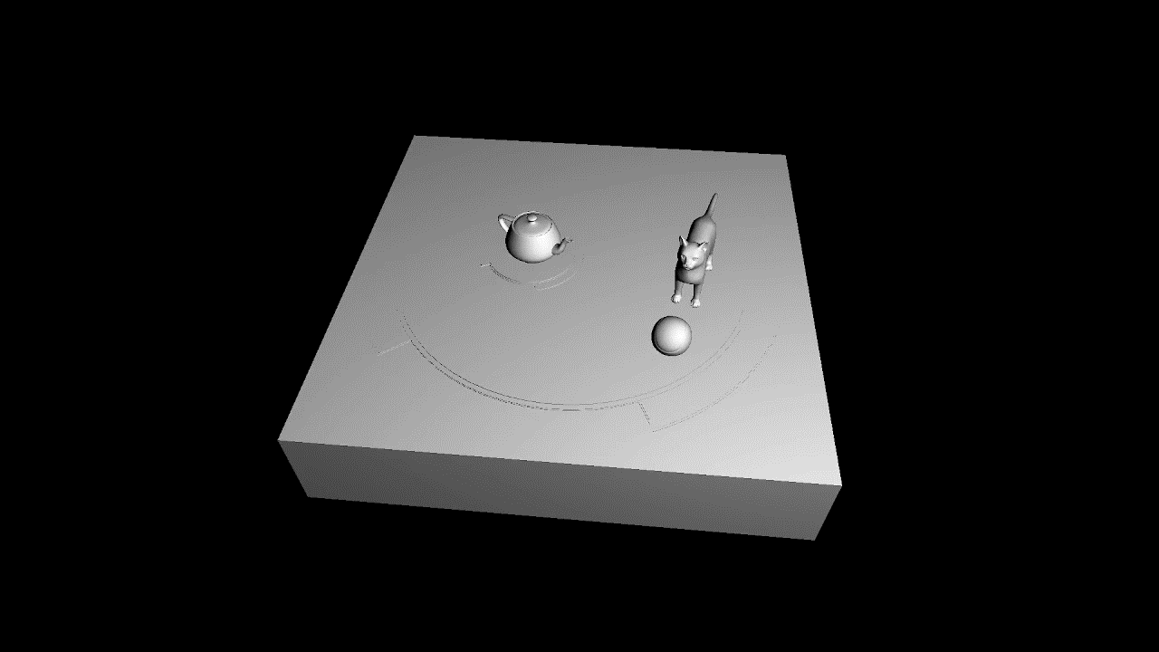
Homework 1 – music box

Slide 21
Homework 1
Camera:
Position: (0, 12, 12)
Target: (0, -1, 0)
Up: (0, 1, 0)
FoV: 45.0
near: 0.1
far: 100.0
Base:
Rotate about +y axis -0.2 degree/frame
Scale (1.25, 1, 1.25)
Teapot disk: (parent: Base)
Rotate about +y axis -1.0 degree/frame
Scale (1, 1, 1) to original size
Teapot: (parent: Teapot disk)
Scale (0.3, 0.3, 0.3) to original size
Disk: (parent: Base)
Rotate about +y axis -0.5 degree/frame
Scale (4, 1, 4) to original size
Cat: (parent: Disk)
Scale (1, 1, 1) to original size
ball: (parent: Cat)
Rotate about +x axis 1.2 degree/frame
Scale (1.2, 1.2, 1.2) to original size
Keyboard input:
Press 1 to double the rotation speed of the disk (press twice, 4 times faster)
Press 2 to half the rotation speed of the disk (press twice, 1/4 slower)
This will also affect its children (cat, ball)

Slide 22
Homework 1 – relative position
base
Teapot disk translate (-1, 1.5, 0)
Disk translate (0, 1.3, 0)
Cat translate(2.5, 0, 0)
cat
T
C
teapot
Ball translate(0, 0.5, 2)
B
ball

Slide 23
Homework 1 - score
Depth testing (pass if less or equal)– 5%
Face culling (counter-clockwise as front, cull back)– 5%
Camera and perspective – 5%
Base (all transform must be correct) – 10%
Teapot disk (all transform must be correct) – 5%
Teapot (all transform must be correct) – 10%
Disk (all transform must be correct) – 5%
Cat (all transform must be correct) – 10%
Ball (all transform must be correct) – 10%
All 4 model correct – 20%
Keyboard input– 15%

Slide 24
Homework 1 - submission
Deadline: 2022/10/18 23:59:59
10% penalty for each week late
Final score = original score * 0.9 for less then a week late (10/19 ~ 10/25)
Final score = original score * 0.8 for one week late (10/25 ~ 10/31)
So on…
Zip and upload visual studio project on E3
Zip name: studentID_HW1.zip

Slide 25
Reference
https://learnopengl.com/
https://www.glfw.org/docs/3.3/index.html

